Slide 1
Towards the Computing Qualifications Standard in Bosnia and Herzegovina
15th Workshop “Software Engineering Education and Reverse Engineering”
Bohinj, 24 - 29 August 2015.
Dražen Brđanin
Faculty of Electrical Engineering, University of Banja Luka, B&H

Slide 2
About this presentation
Research/Project framework
National qualifications standards
B&H state/high education specificities
Comparative analysis of CC at B&H universities
Initial proposal for B&H Computing QS

Slide 3
Research/Project framework
European Commission/Council of Europe Project:
“Strategic Development of Higher Education and Qualifications Standards”
Duration: 2013-2015
Project objectives:
…
Development of B&H Qualifications Standards for five selected HE fields (ICT, agriculture and food processing, education, civil engineering, economy)
Development of B&H Occupational Standards for two selected HE fields (ICT, agriculture and food processing)
…
Participants:
Project: ~100 domain experts (industry, academia, ministries) + EU experts
ICT group: ~20 participants (public & private universities, ICT industry)

Slide 4
National qualifications standards
National Qualifications Framework (NQF)
a formal system describing qualifications
47 countries participating in the Bologna Process are committed to producing a NQF
Why NQF?
Makes it easy: recognition, mobility and employability, through: clarity, comparability, portability, quality and relevance
What NQF includes?
Some/ALL qualifications levels (from elementary to high education)
Some/ALL qualification classes: complete/partial (major, minor, additional, supplementary, special purpose)
Some/ALL education types (formal/unformal/informal)
New/ALL (old included) qualifications
NQF objectives:
Presentation of the national qualification system
Modernization of the national educational system
Strengthening cooperation between stakeholders
B&H (as a Bologna Process participant) is committed to develop a NQF, but…

Slide 5
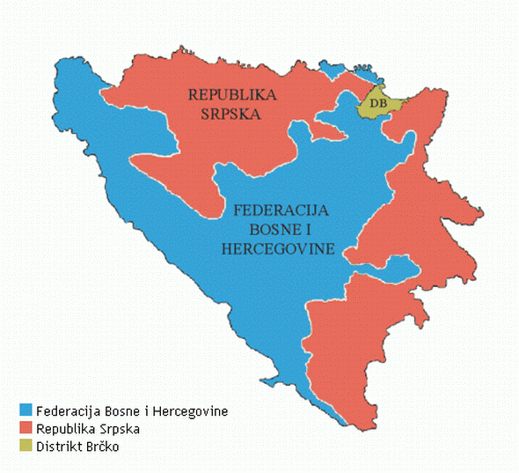
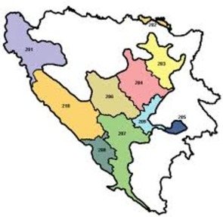
B&H State/High education specificities
Complex state structure (2 entities + 1 district)
Federation of Bosnia and Herzegovina =
10 cantons
Complex and “distributed” high education jurisdiction :
State level: framework law for HE + state agency for quality assurance in HE
Entity/Canton level: different own laws for HE + entity/canton ministries & agencies

Slide 6
B&H State/High education specificities
Some B&H demographic/statistical indicators
 | Number of inhabitants | Total number of HE institutions | Number of public universities | Number of private universities | Number of other HE institutions (colleges, …) | Inhabitants per HE institution
Republic of Srpska | 1.33M | 20 | 2 | 7 | 11 | 66k
Federation of B&H | 2.37M | 20 | 6 | 9 | 5 | 118k
Brcko District | 93k | 3 | - | 2 | 1 | 31k
B&H total | 3.79M | 43 | 8 | 18 | 17 | 88k
High Education is the fastest growing industry in Republic of Srpska!!! ☹
Total of 25 different CC in Republic of Srpska (~10 “business informatics”) !!!
More than 50 different CC in B&H !!!
The most important demand for developing B&H Computing QS

Slide 7
Analysis of CC at B&H universities
Research goals:
Compare computing curricula at different (selected) B&H universities to identify similarities and differences between each other
Understand these differences in order to:
propose future steps needed to modify these programs so that one can match current and expected future industry needs and international recommendations
propose the initial B&H Computer Science Qualifications Standard
Selected (public) B&H universities / curricula:
University | Computing Curricula | Years / ECTS | Label
University of Banja Luka | Computing and Informatics | 4 / 240 | RI_ETF_UNBL
University of Banja Luka | Mathematics and Informatics | 4 / 240 | INF_PMF_UNBL
University of Sarajevo | Computing and Informatics | 3 / 180 | RI_ETF_UNSA
University of Tuzla | Computer Science and Informatics | 4 / 240 | RI_ETF_UNTZ
University “Dzemal Bijedic” Mostar | Information Technologies | 3 / 180 | IT_FIT_UNMO

Slide 8
Analysis of CC at B&H universities
Why public universities?
Unfortunately, nominated representatives of all private universities were almost unrepresentative and inactive,
All selected faculties have own computing curricula for >15 years
Some faculties have respected tradition in computing education for >40 years
All selected curricula have satisfactory maturity
Some selected curricula are accredited by ASIIN and internationally recognized
History of computing education at the Fac. of Electrical Engineering Banja Luka
1962.
TF BL
founded
1972.
C&A
pr.
1975.
TF→FEE
C&A dpt
1988.
new CC
(5y)
1995.
new CC
(5y)
2003.
C&A→C&I
p: IT, CE (4y)
2008.
1/2 c.
ASIIN
2010.
1/2/3 c.
2014.
IT→SE
CE→CE

Slide 9
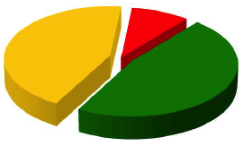
Analysis of CC at B&H universities
Analysis and findings
~200 courses identified in all five CC
We realized that there are three main groups of courses:
group where courses are present only in one or two curricula
Group containing the courses present in most of the selected curricula
9%
44%
47%
group containing the courses present in all curricula

Slide 10
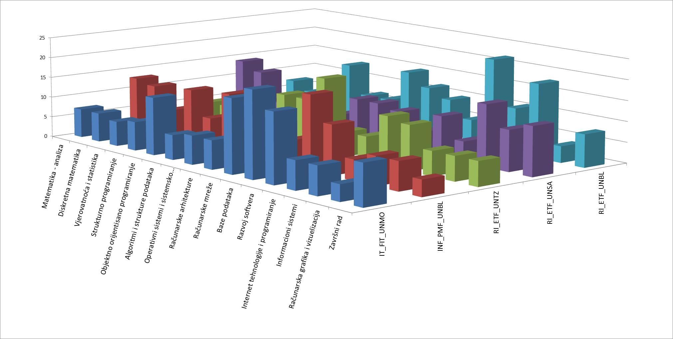
Analysis of CC at B&H universities
Courses/Modules contained in all curricula (47%):
Calculus
Discrete Mathematics
Probability and Statistics
Proc. and OO Programming
Algs. and Data Structures
Operating Systems
Computer Architectures
Networks
Databases
Software Development
Internet Programming
Information Systems
Computer Graphics
Final Project
14 common modules
5-20 ECTS/module
Curricula mostly inline with IEEE, ACM and EuroInf recommendations

Slide 11
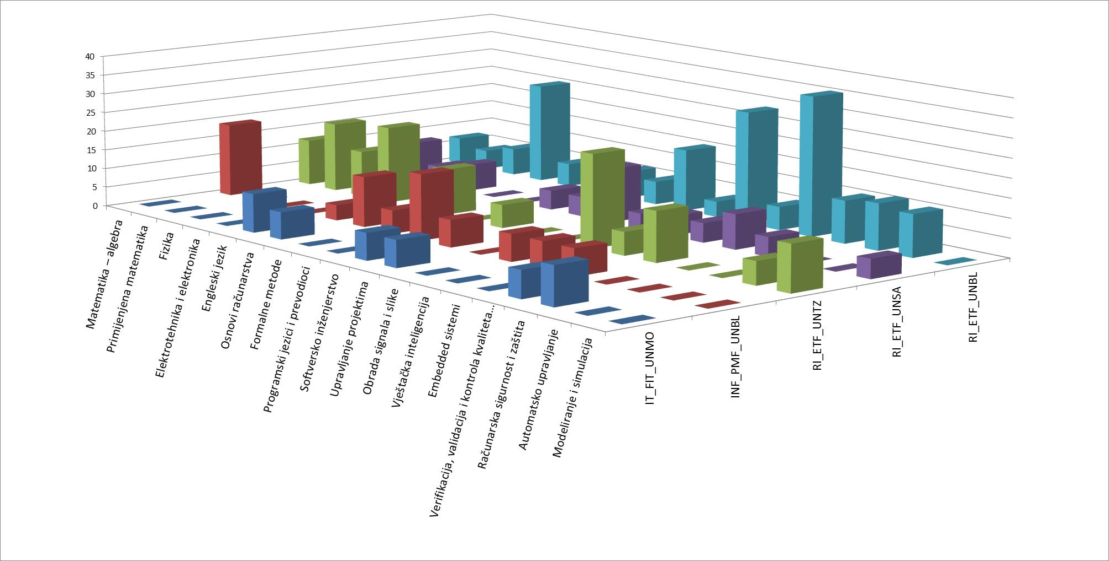
Analysis of CC at B&H universities
Courses/Modules contained in most of curricula (44%):
Algebra
Applied Mathematics
Physics
English Language
Electronics and IC Design
Introduction to CS
Formal Methods
Compiler Design
Software Engineering
Project Management
Digital Signal Processing
Artificial Intelligence
Embedded Systems
Reasons:
different study duration (3/4y)
different background and orientation (El. Eng, Fac. of Sci.)

Slide 12
Initial Proposal for B&H Computing QS
General
Qualification name | Bachelor of Computing
Minimal volume | 180 ECTS
Level | 6
Mandatory modules | Learning outcomes | Min. ECTS
Mathematics | … | 16
Theoretical Foundations of Computing | … | 10
Programming Paradigms and Programming Languages | … | 18
Operating Systems and System Programming | … | 6
Computer Architecture and Organization | … | 10
Networking and Communications | … | 6
Databases and data management | … | 8
Software Engineering and Software Development | … | 20
Computer and Data Security | … | 5
Foreign Languages | … | 5
Final Project / Thesis | … | 6
Mandatory ECTS (CS, EE, Math) |  | 110
Subjects not belonging to CS, EE, Math |  | ≤30
Competences at the level of qualification
Knowledge | …
Skills | …
Abilities | …

Slide 13
Instead of the Conclusion
Please,
share Your experience
with the National Qualifications Standard
for Computing in Your Country!
Thank You!

